Slide 1
Resharper Templating

Slide 2
Live Templates
Built in templates….
foreach
Context available
Will look at last collection
Control-E, Control-L will list
List which shows is in context per type of code being written

Slide 3
Surround Templates
Highlight Code
Control-E, Control-U
Can pick from list
Example- region

Slide 4
File Templates
Control-Alt-Insert
Will use Template Explorer List

Slide 5
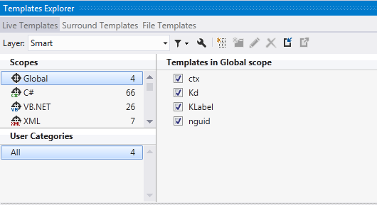
Template Explorer
From Resharper
Various Scopes

Slide 6
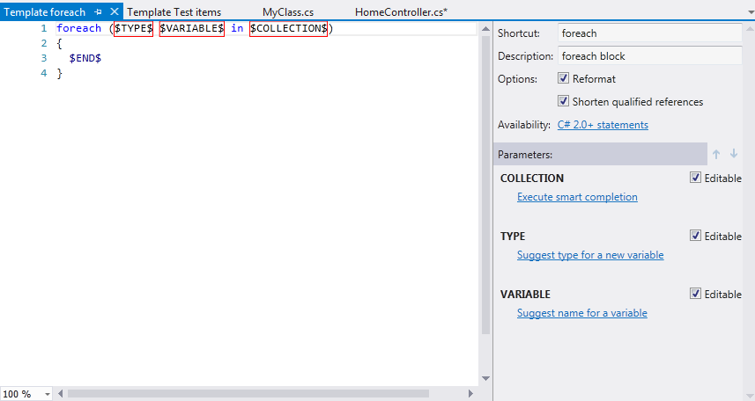
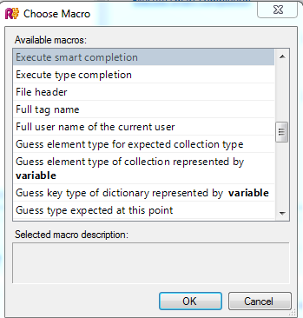
Learn From JetBrains

Slide 7
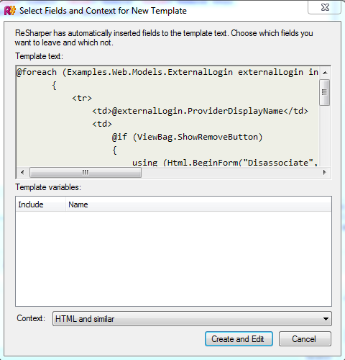
Take Code and Make Template
Highlight Code
Resharper -> Tools-> Create Live Templatate From Selection

Slide 8
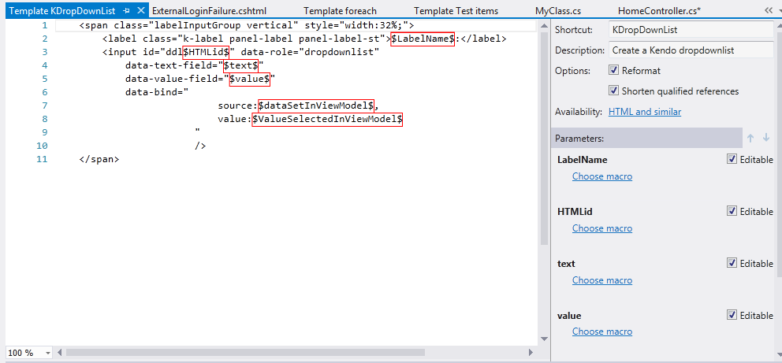
Roll your own

